Slide 1
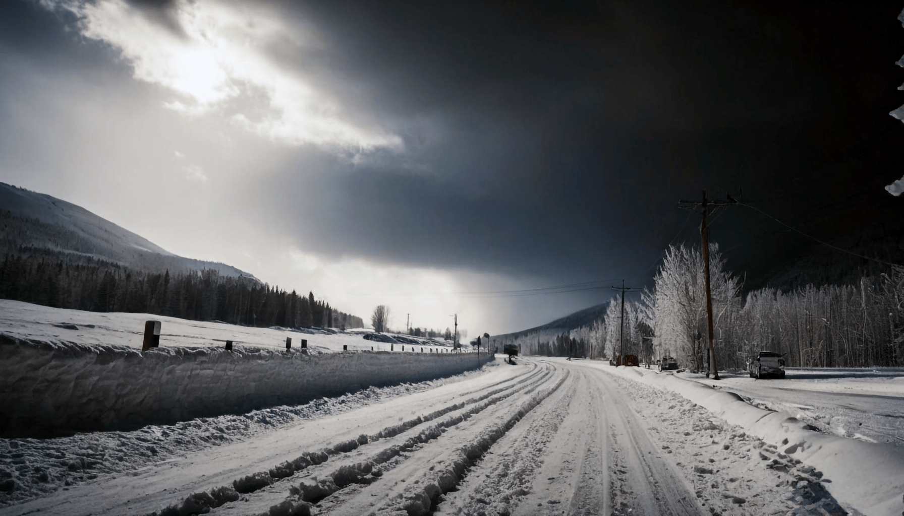

ENVIRONMENTAL DATA ANALYSIS FOR CLIMATE CHANGE PREDICTION
TEAM MEMBERS: MILIND, HARSH, AYUSH, BHARAT

Slide 2

Why is it important to learn about weather patterns and climate?
Climate change is one of the most pressing global challenges, driven by human activities and natural processes. This project focuses on analyzing large-scale environmental datasets to predict climate change impacts, such as trends in temperature, pollution, and ocean conditions.

Slide 3

AI FOR CLIMATE CHANGE & WEATHER FORECAST
AI can be a powerful tool to help mitigate climate change, and the challenges related to extreme weather conditions.
Here are some ways AI can help with climate change:
Early warning systems
Post-disaster recovery
Modeling climate change
Monitoring climate treaties
Improving agriculture
Predicting weather
Tracking icebergs
Identifying pollution

Slide 4
OBJECTIVES
1
2
3
4
Collect and preprocess environmental datasets, including temperature, sea level water pressure, and air quality data.
To analyze trends in these datasets and identify key indicators of climate change.
To develop machine learning models that predict future climate change impacts based on historical and current environmental data.
To forecast future scenarios such as temperature rise, pollution levels, and sea level rise.

Slide 5

TOOLS AND TECHNOLOGIES
01
Python, Pnadas, NumPy, Seaborn
02
Matplotlib, Plotly for data visualization
03
TensorFlow, Keras for machine learning models
04
Scikit-learn for traditional machine learning
05
Geospatial tools like QGIS or GeoPandas

Slide 6

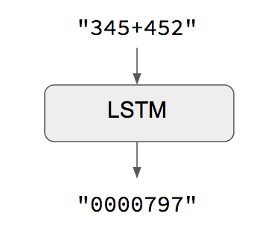

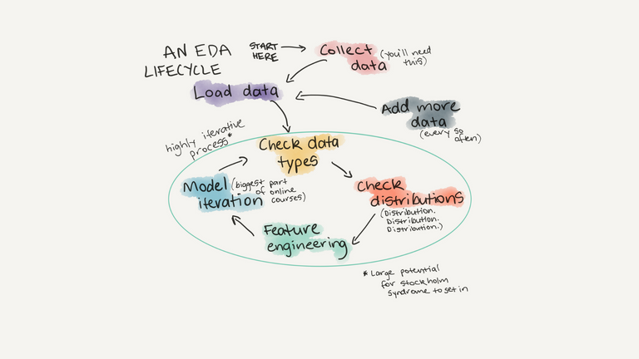

STEPS
Data COllection
MODEL BUILDING & PREDICTION
RESULTS & FORECAST
EXPLORATORY DATA ANALYSIS
MODEL EVALUATION
Collect the data using the meteostat API, and various other online sources.
Build a Neural Network model, specifically LSTM & to make future weather predictions.
Forecast of the weather, and visualized on the map of New York City.
Perform a detailed Exploratory Data Analysis, and preprocess the dataset.
Evaluation of the predictions comparing the actual data, and accuracy check.

Slide 7
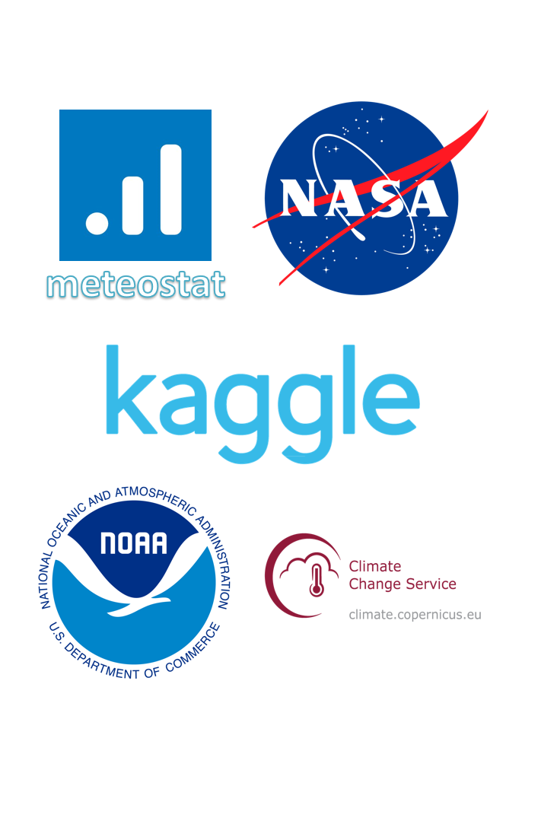
DATA SOURCES
Meteostat.net
NASA Goddard Institute for Space Studies (GISTEMP)
NOAA Global Historical Climatology Network (GHCN)
Copernicus Climate Change Service (C3S)
ERA5 Reanalysis (ECMWF)
Carbon Dioxide Information Analysis Center (CDIAC)
Sea Level Data (NOAA & NASA)

Slide 8

EXPLORATORY DATA ANALYSIS
An Exploratory Data Analysis (EDA) on weather data would involve examining key variables like temperature, humidity, precipitation, wind speed, and pressure over time to identify patterns, trends, seasonal variations, outliers, and relationships between different weather elements, typically using visualizations like line plots, histograms, box plots, scatter plots, and heatmaps to gain insights into the climate of a specific location.

Slide 9
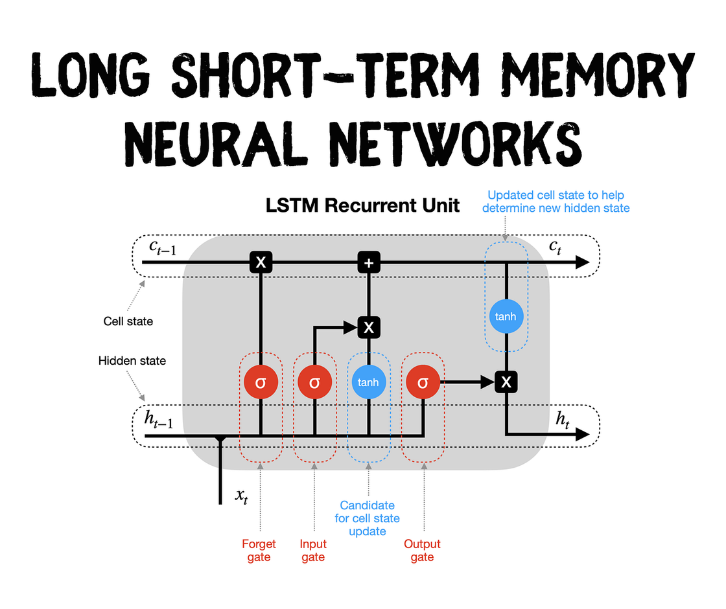
MODEL BUILDING & PREDICTION
Neural networks (NNs), including SwinVRNN, SwinRDM, FuXi, GraphCast, and LSTM, are used for weather prediction in various ways.
LSTM: LSTMs (Long Short-Term Memory) are commonly used for weather prediction because they excel at capturing temporal dependencies in sequential data, meaning they can effectively learn patterns and trends from historical weather data over time, allowing for more accurate predictions of future weather conditions.
SwinVRNN: A Swin Transformer-based Variational Recurrent Neural Network that combines deterministic predictions with stochastic perturbations to improve medium-range weather forecasting.

Slide 10
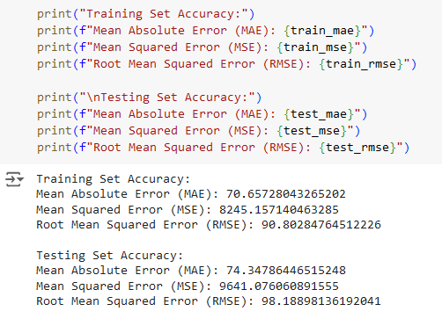
MODEL EVALUATION
In machine learning, when evaluating a model, "MSE" (Mean Squared Error), "MAE" (Mean Absolute Error), and "Accuracy" are common metrics used to assess its performance, with MSE and MAE primarily used for regression tasks, while accuracy is typically used for classification problems; MSE measures the average squared difference between predicted and actual values, MAE measures the average absolute difference, and accuracy represents the proportion of correct predictions made by the model

Slide 11
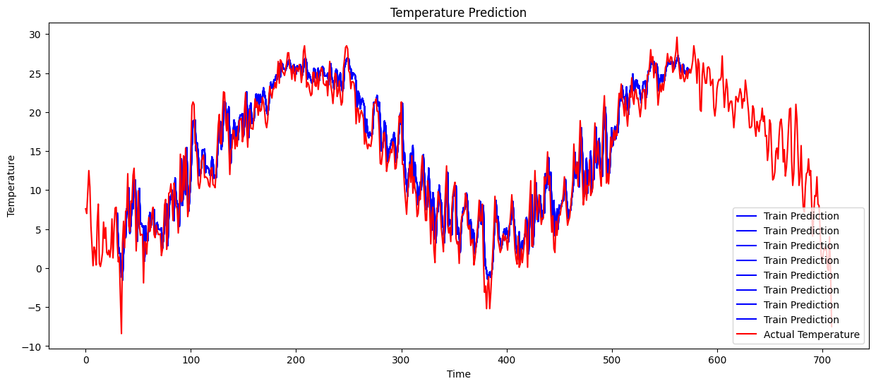
RESULTS & VISUALIZATION
LSTM model has effectively captured weather trends, closely aligned predictions with actual temperatures, particularly for long-term variations. While it performed well overall, it may struggle with rapid fluctuations. The overlap between forecasts and actual data indicates good training. Overall, the model demonstrated promising results but requires further validation to ensure generalization and robustness for real-world applications.

Slide 12
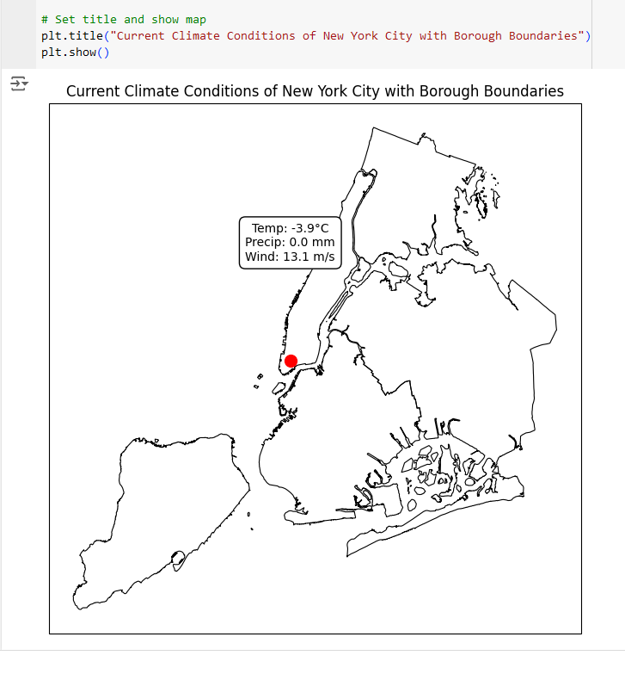
RESULTS & VISUALIZATION
Geopandas is a Python library used to visualize weather data by allowing you to plot geographic information, like temperature or precipitation, on a map, leveraging the spatial coordinates of weather data points to create visualizations like choropleth maps, point maps, or heatmaps, effectively showing weather patterns across different regions on a map.

Slide 13
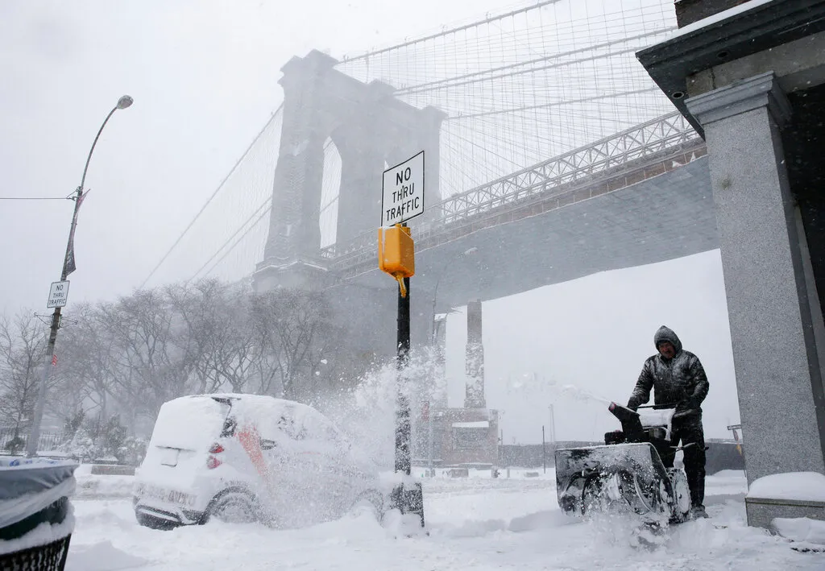
CONCLUSION
Seasonality in Temperature: NYC likely shows typical seasonal patterns, with warmer summer months and cooler winters.
Precipitation Trends: Identify periods with higher rainfall, such as spring and fall, and any unusual spikes that may suggest storms or extreme weather.
Anomalies or Extremes: Spot any unusual temperature or precipitation events, such as heat waves or heavy storms.
Warning System & Preparedness: Disaster risk assessment, extreme weather warnings, and providing valuable insights for climate change mitigation strategies by enabling detailed analysis of future weather patterns and potential climate impacts.

Slide 14
REFERENCES
https://meteostat.net/en/
https://www.kaggle.com/datasets/muthuj7/weather-dataset
https://www.ncdc.noaa.gov/cdo-web/datasets
https://science.nasa.gov/climate-change/
https://www.nccs.nasa.gov/services/climate-data-services
https://medium.com/@sebastienwebdev/forecasting-weather-patterns-with-lstm-a-python-guide-without-dates-433f0356136c
https://www.sciencedirect.com/science/article/pii/S0360132321000160
https://medium.com/pythons-gurus/using-geopandas-for-geospatial-time-series-visualizations-5f055f509316

Slide 15
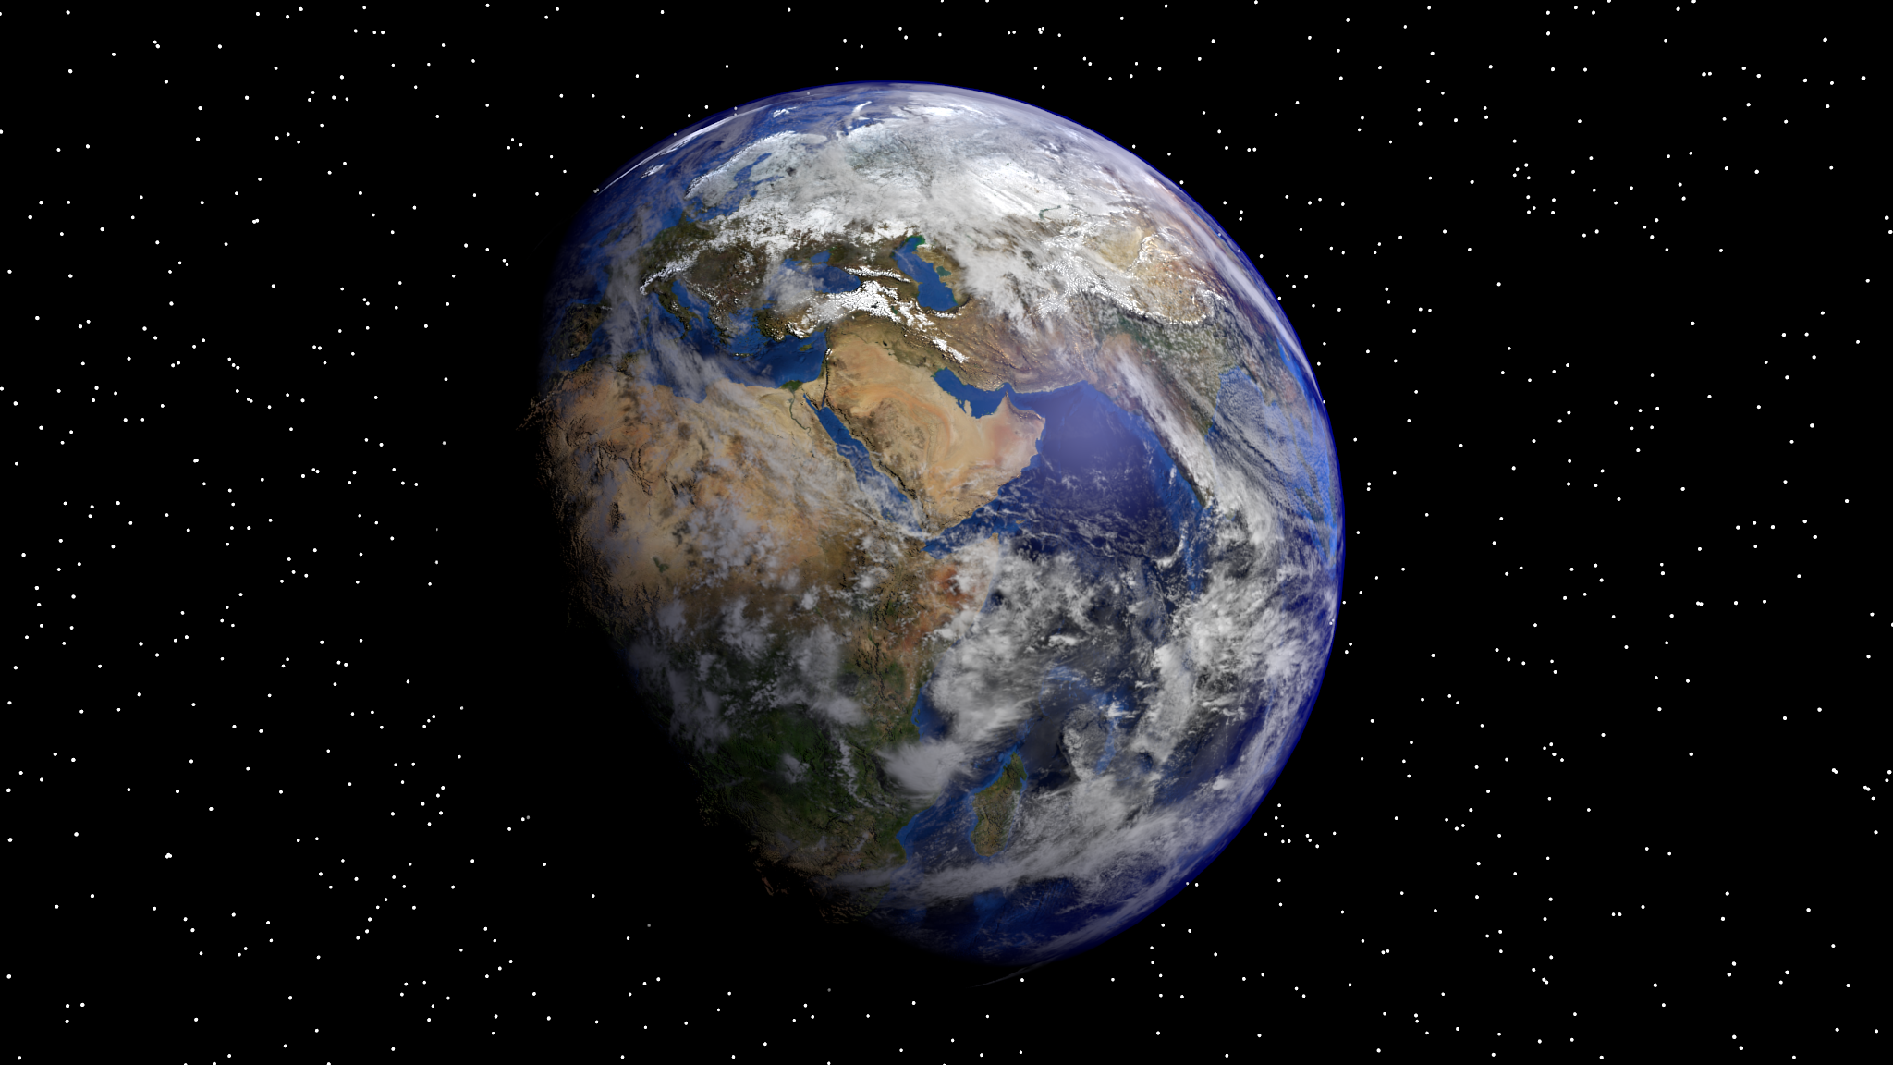
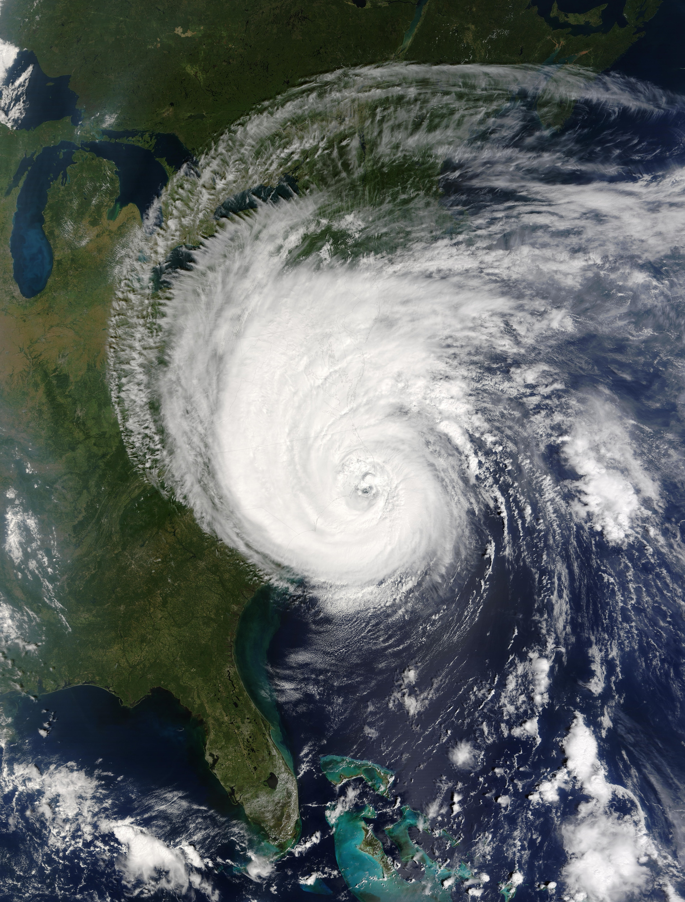

Light RAIN ALERT : STAY HOME, STAY SAFE!
THANK YOU!

